Slide 1
Djeca s posebnim potrebama
Prag, 11. travnja – 15. travnja 2018.

Slide 2
Tko su djeca s posebnim potrebama?
Djeca s teškoćama su:
djeca s teškoćama u razvoju
djeca s poteškoćama u učenju
djeca s emocionalnim problemima
djeca s problemima u ponašanju
djeca s teškoćama uvjetovanim socijalnim, ekonomskim, kulturnim i jezičnim čimbenicima
Talentirana i darovita djeca

Slide 3
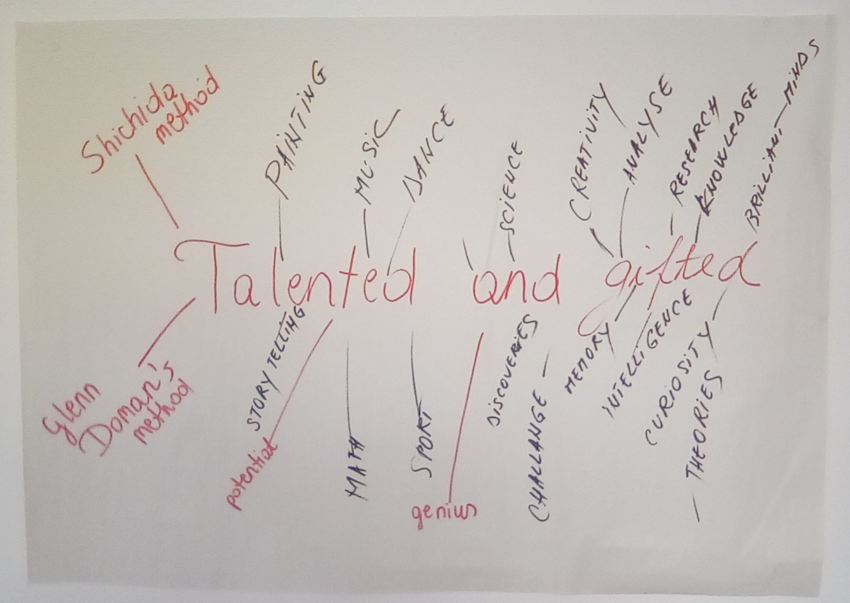

Slide 4
Očekivanja polaznika tečaja

Slide 5
Standardizirani sustav

Slide 7
Vrste uključivanja

Slide 8
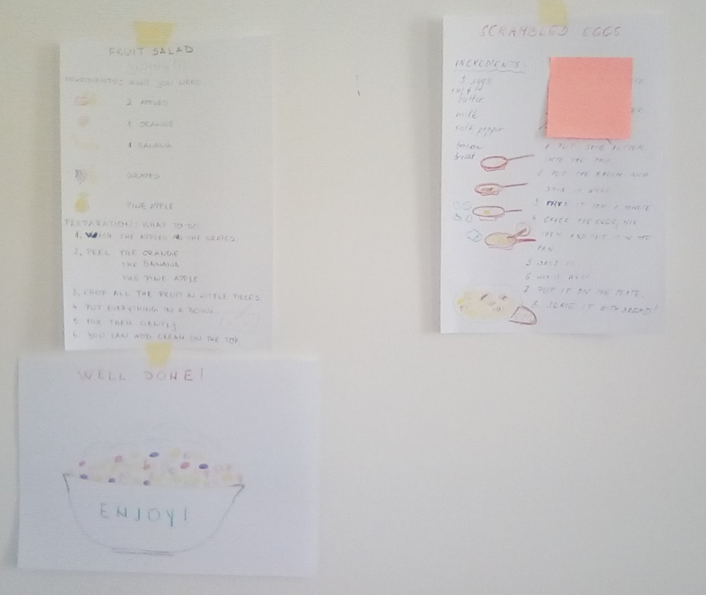
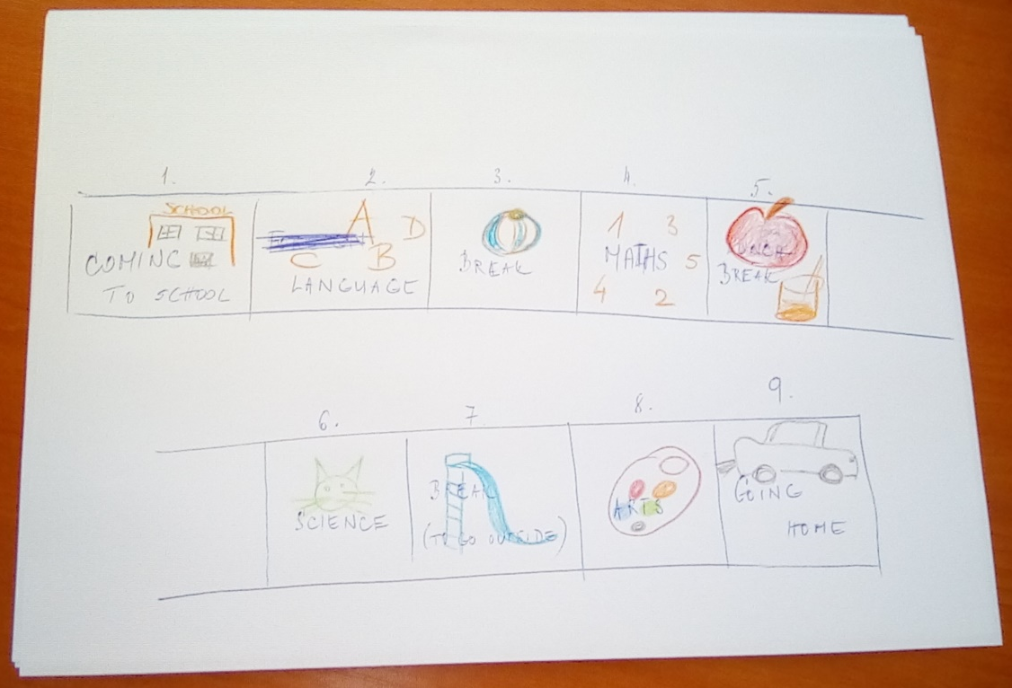

Slide 9
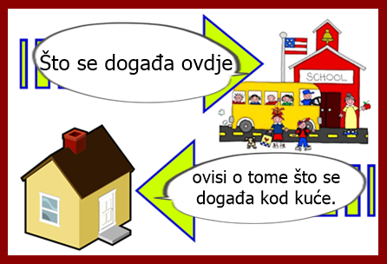
Individualni planovi: napravljeni prema sposobnostima i potrebama djece
Suradnja s roditeljima
Učenje projektima: potiče motivaciju i samopouzdanje, kreativno i kritičko mišljenje
ICT kao motivacija

Slide 10
http://www.specialneedsparents.ie/assets/Guidelines-on-the-Individual-Educational-Plan-Process.pdf
https://.european-agency.org/
https://www.kit.org/what-we-do/inclusion-resources/
http://ncse.ie/wp-content/uploads/2014/10/ChildrenWithSpecialEdNeeds1.pdf
http://www.ed.gov.nl.ca/edu/k12/studentsupportservices/publications/TeachingStudentsGiftedTalented.pdf
https://www.tablexia.cz/encyclopedia/3/
https://www.ted.com/talks/sir_ken_robinson_bring_on_the_revolution

Slide 11
Hvala na pažnji!

Slide 12
Literatura:
Bechyňová, L. (2018), Introduction
Bechyňová, L. (2017), Project based learning (and cross curricular activity in an inclusive classroom)
Bechyňová, L. (2018), Information easy to read and understand
Bechyňová, L. (2018), Creating and using the individual plan for students with special needs
Sabolová, K. (2017), Communication and Cooperation with Parents and Family
Bechyňová, L. (2018), Activities for gifted and talented children
Bechyňová, L. (2018), Structural learning for students with autism
Šichova, A. (2018), Special needs children
Šichova, A. (2017), Introduction, Integration and inclusion, exclusion, mainstreaming, identification risks, factors and barriers
Šichova, A. (2018), Experiential Learning, Creative Thinking, Task Based Learning
[Powerpoint prezentacije održane na tečaju Djeca s posebnim potrebama održanom 16. – 20. 4. 2018. u Pragu]

