Slide 1
Erasmus Days 2021 in Primary School „Petar Zoranić” Nin, Croatia
Elvira Vučković
Project Coordinator
October 14, 2021

Slide 2
Lecture content:
presentation of our school
presentation of project team members
goals of our Erasmus accreditation
Link for Certificates: https://forms.office.com/r/RzGbuQ9qV2

Slide 4
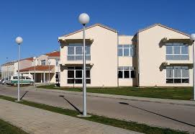
Primary school „Petar Zoranić” Nin
50 employees
around 300 students (6-14 years)
School buildings in Nin, Vrsi, Zaton, Ninski Stanovi
link to the school website

Slide 5
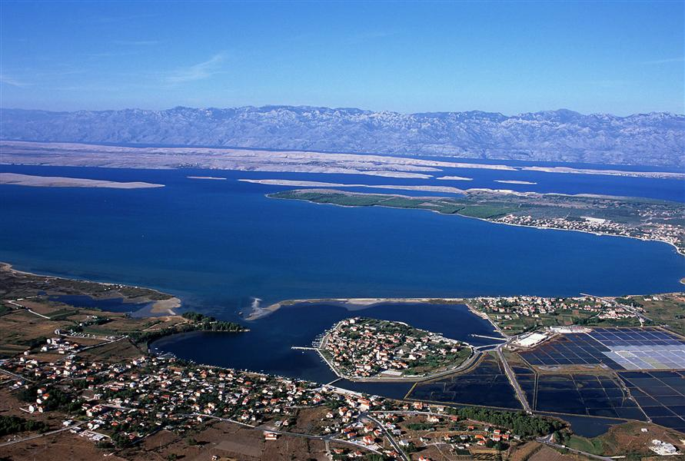
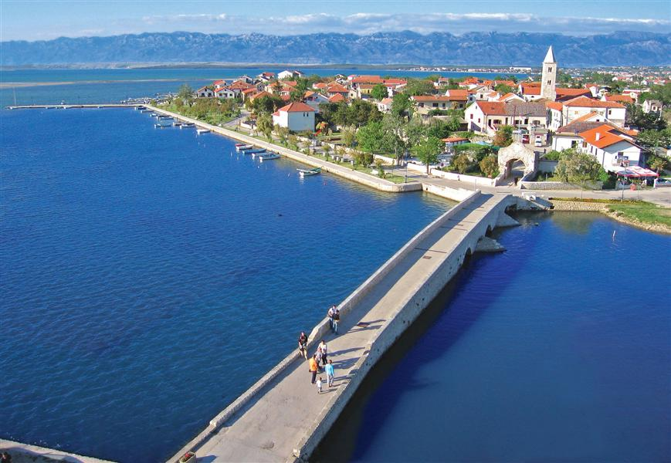
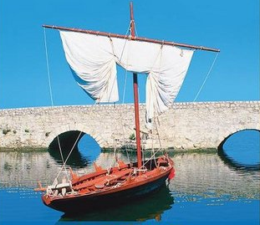
Condura Croatica:
old croatian boat

Slide 6
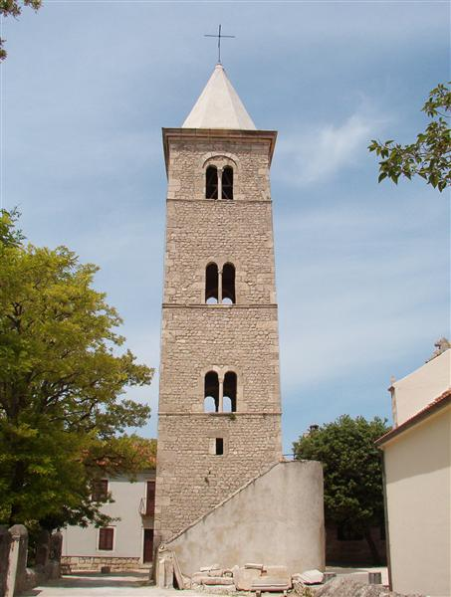
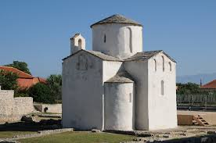
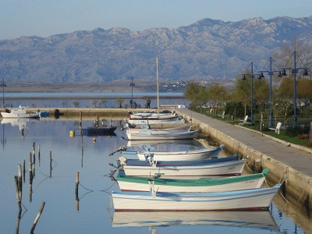
The Church of the Holly Cross

Slide 7
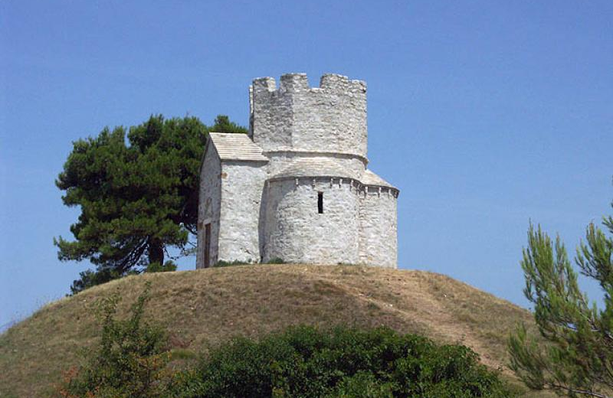
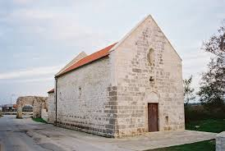
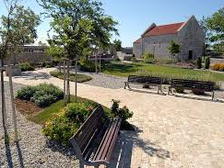
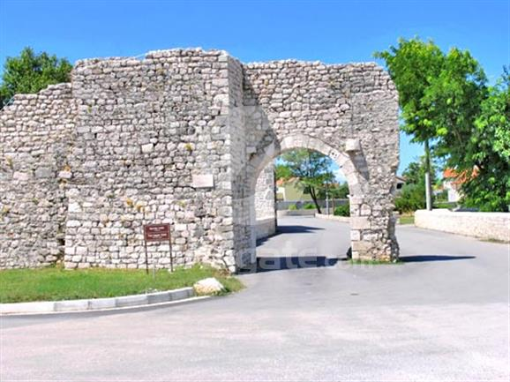
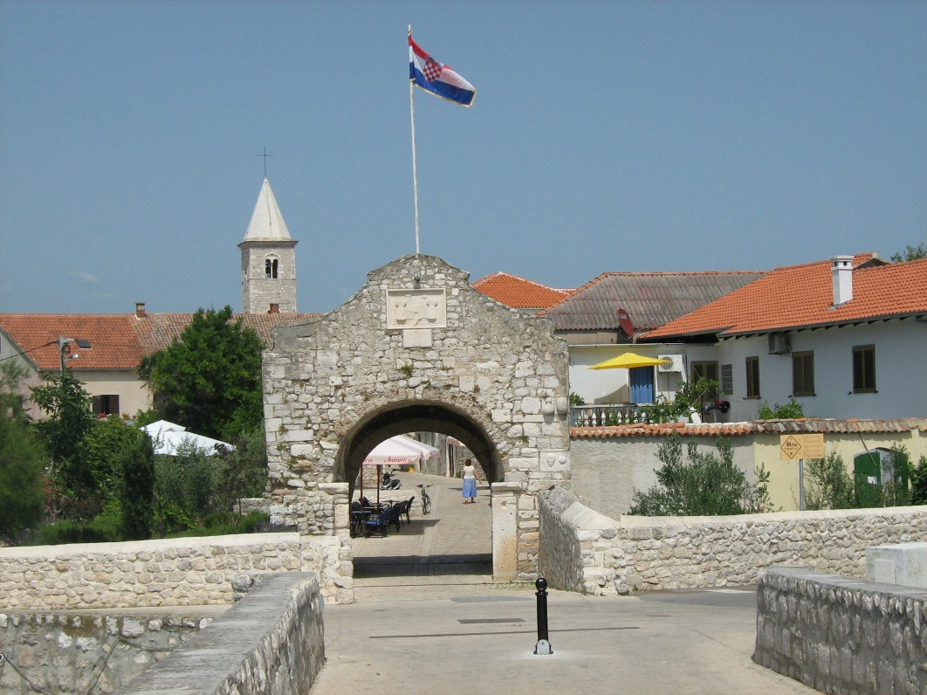

Slide 8
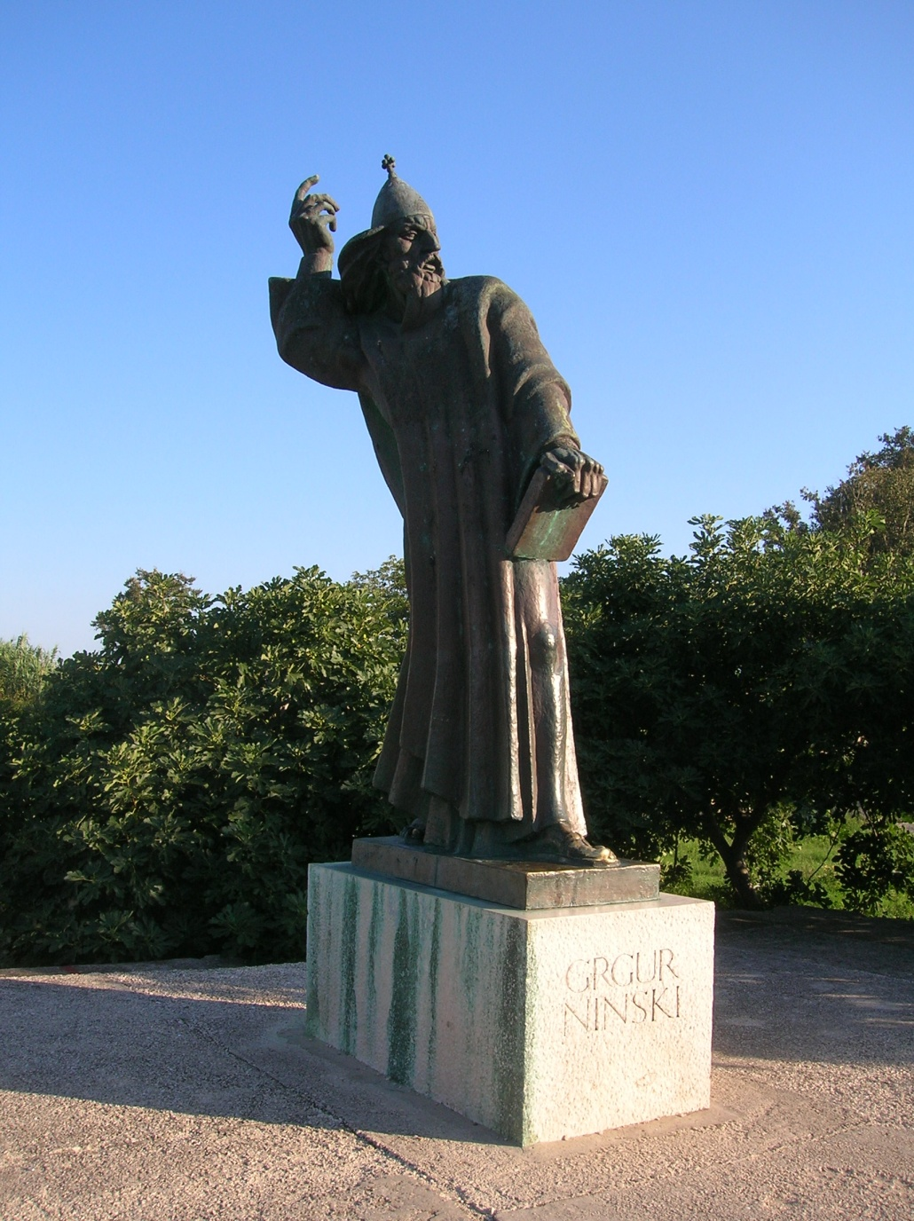
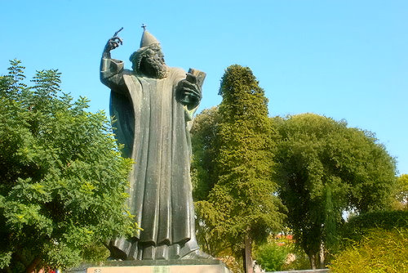
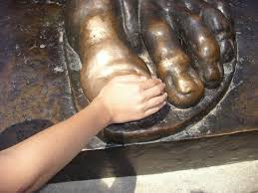

Slide 9
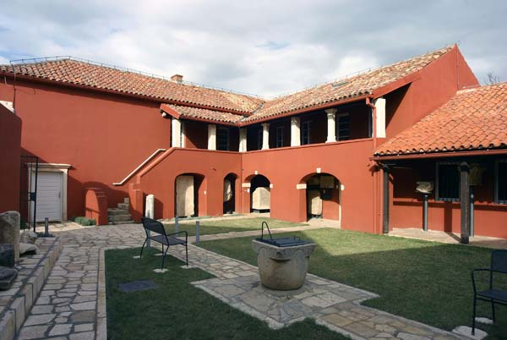
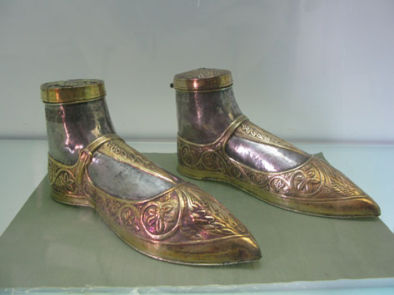
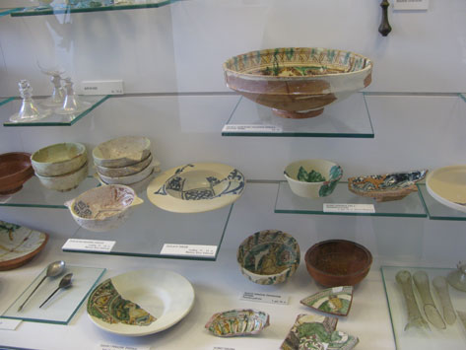
Museum of Nin Antiquities

Slide 10
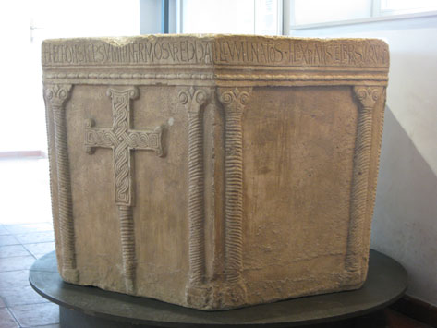

Slide 11
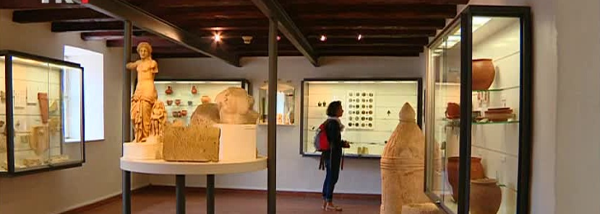
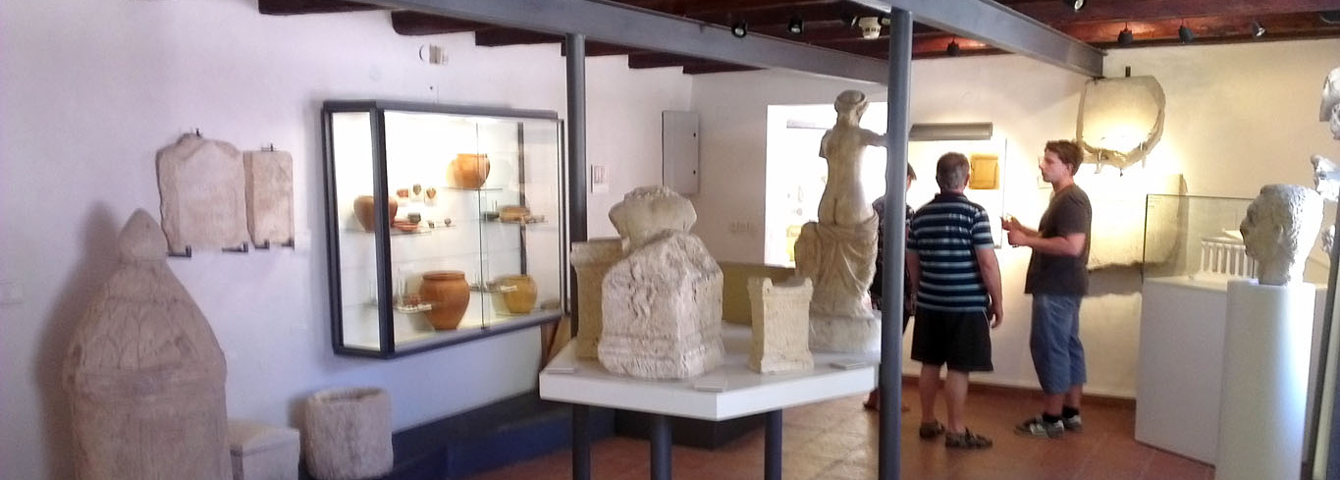

Slide 12
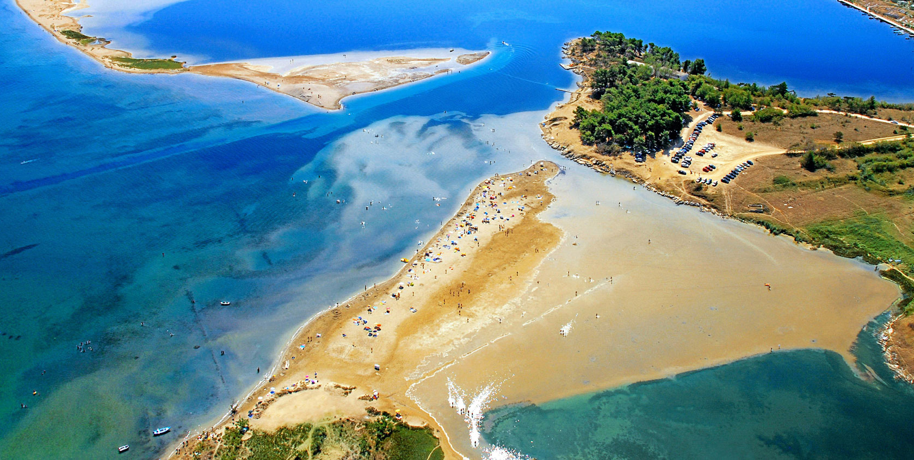

Slide 13
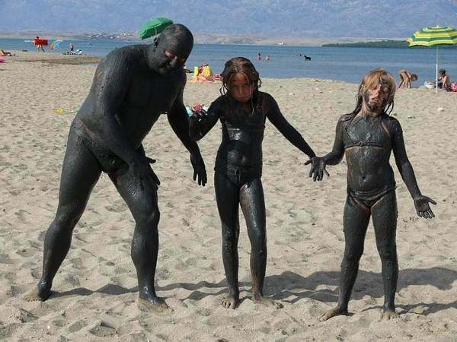
Healing mud (peloid)

Slide 14
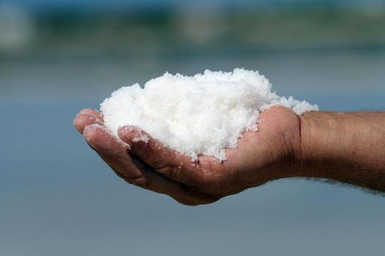
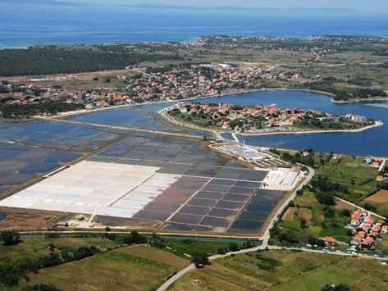
Nin Salt Work

Slide 15
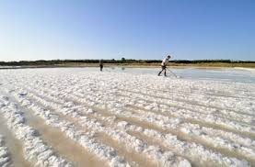
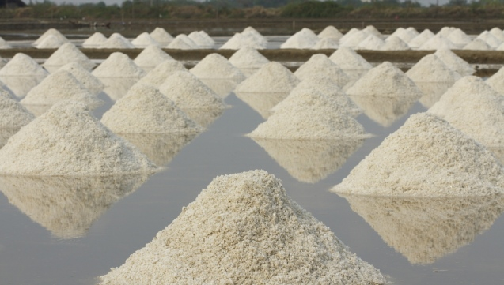
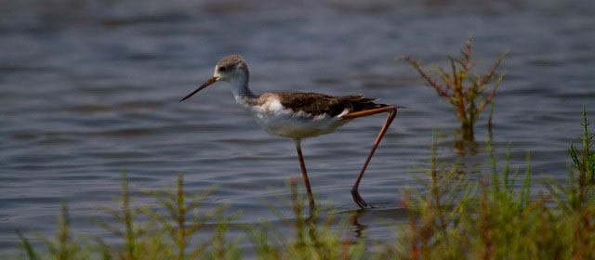
Ornithological reservation

Slide 16
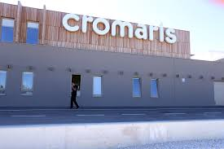
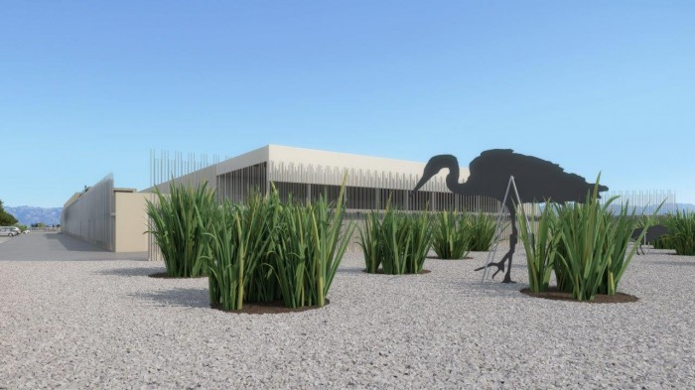
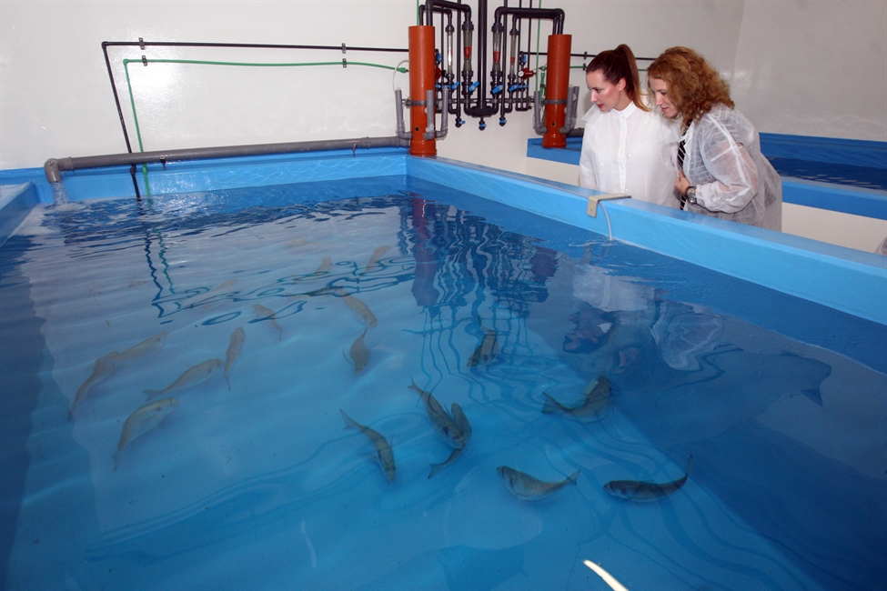
Fish farm Cromaris

Slide 17
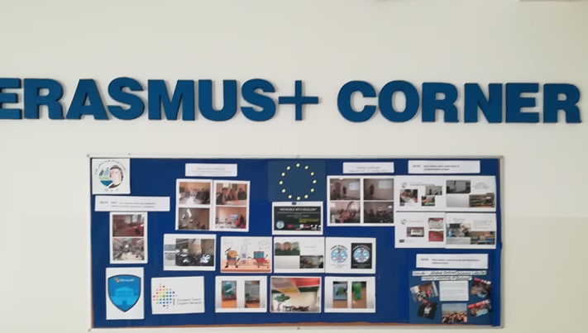

Slide 18
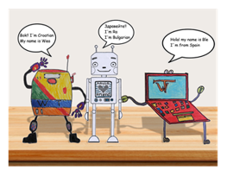
Erasmus+ KA2 project „Wearable Methodology A New Methodology Based On The Use Of Innovative Technologies For Education” Free software, activities and guide: http://www.wearablemethodology.eu/

Slide 19
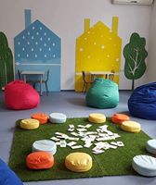
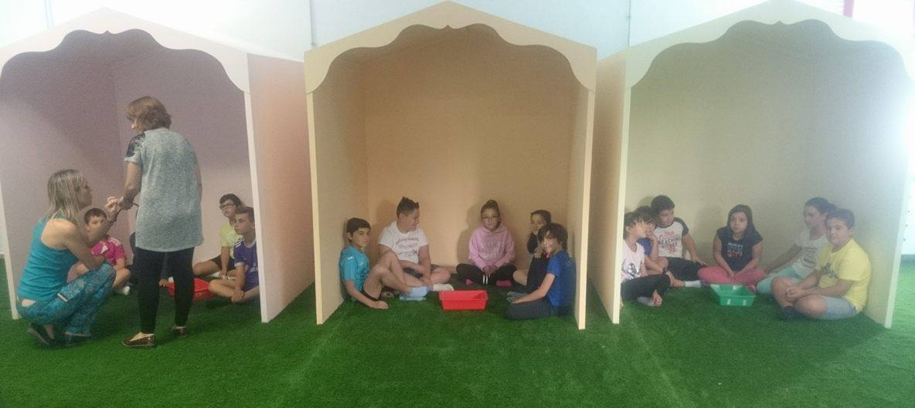
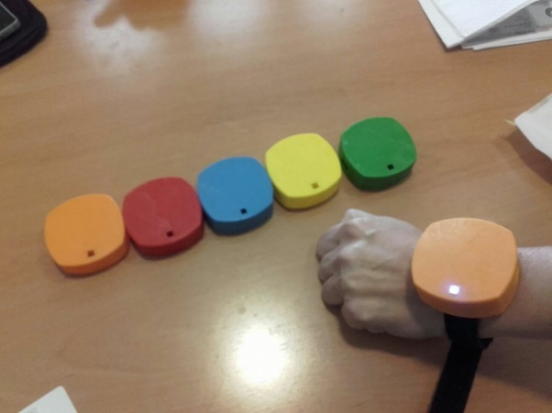
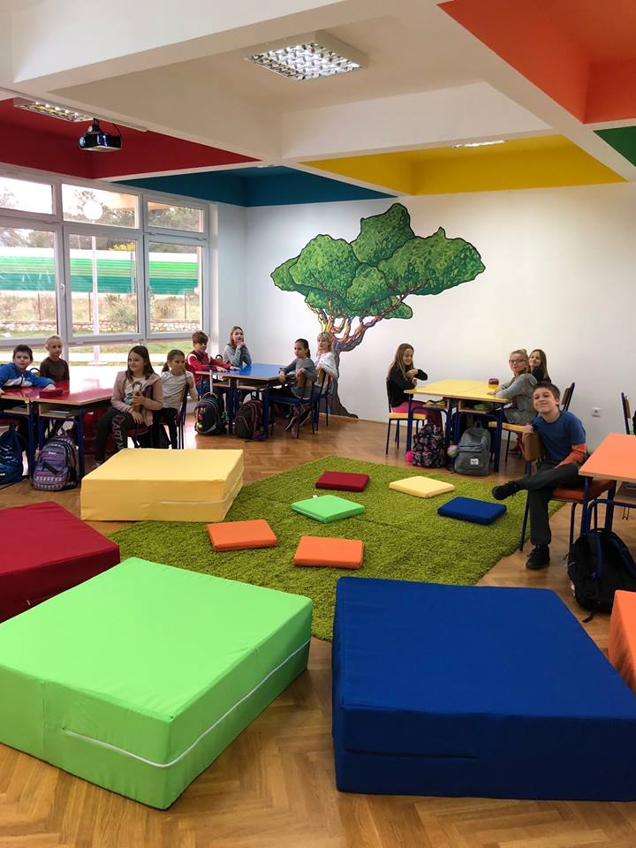
„Wearable Aula”
Video

Slide 20
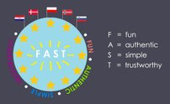
Fun, authentic, simple and trustworthy
(FAST)
Duration: 1.9.2017. - 29.2.2020.
Grant amount: € 91,000.00
http://erasmus.tips/​

Slide 21
Erasmus+ KA 1 projects
- 20 structured courses,
- 4 job shadowings

Slide 22
Objectives of our Erasmus Acreditation
Strengthening the European dimension of learning and teaching through improving school governance
Increasing the quality of learning and teaching of all students, with an emphasis on learning and teaching students with special needs through innovative ways of teaching
Creating a safe place to learn and teach through reducing the incidence of bullying and cyberbullying among students

Slide 23
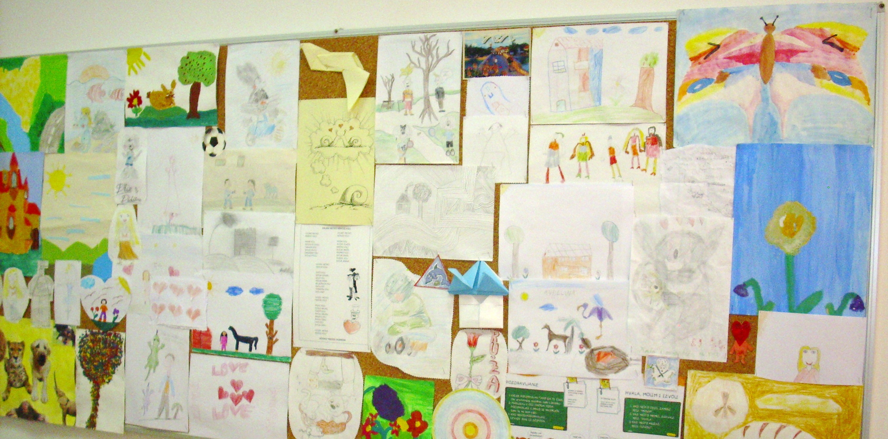
Elvira Vučković - school psychologist - project coordinator
cognitive behavioral therapist
educated for working with children with depression and suicidal risk,
member of the team for crisis interventions,
trainer in community-based mental health care
mentor for psychology students of University in Zadar
postgraduate student at Radboud University (RITHA Practitioner Programme), …

Slide 24
Interests:
education of children with special educational needs (gifted, with difficulties)
examples of good practice
self-regulation of learning, emotions, development of social skills

Slide 25
I am interested in experiences from other schools:
extracurricular teaching, outdoor teaching
working with students with health difficulties
gifted and talented students

Slide 26
KA2
Wearable Methodology (project partners Anton Diaz School and the University of Castilla La Mancha ( Spain), Bulgaria St. Kliment Ohridski School)
Project FAST ( Fun, Authentic, Simple and Trustworthy, 2017. -2020.)
Project partners were from Denmark, Norways, Slovenia and Poland

Slide 27
Participants in student mobilities are students with special needs:
Gifted students
Twice exceptional students
Students with difficulties
Short-term group mobilities

Slide 28
Contact: elvira.vuckovic@skole.hr
Evaluation: https://www.menti.com/gendhmfbdz

Slide 29
This publication [communication] reflects the views only of the author, and the Commission cannot be held responsible for any use which may be made of the information contained therein.

