Slide 1
Erasmus Days 2021 in Primary School „Petar Zoranić” Nin, Croatia
Project Team
October 14, 2021

Slide 2
Iva Maras
I am the teacher at the OŠ „Petar Zoranić“ – Nin.
I work with children from first to fourth grade.

Slide 3
I participated in Erasmus+ courses:
Creation Summer School Developing an Engaging Science Classroom (Greece, 2016.)
Student – Centred Methodology: Teachers as Promoters of Active Learning (Italy, 2018.)
Sharing Landscapes (Greece, 2018)
We are All Special – Inclusion and Support to Special Needs Students in and out of Classroom (Spain, 2019.)
FAST, WM (KA2) – member of the project team
I am post-graduate student at Radboud University, Netherland – RITHA Specialist Programme

Slide 4
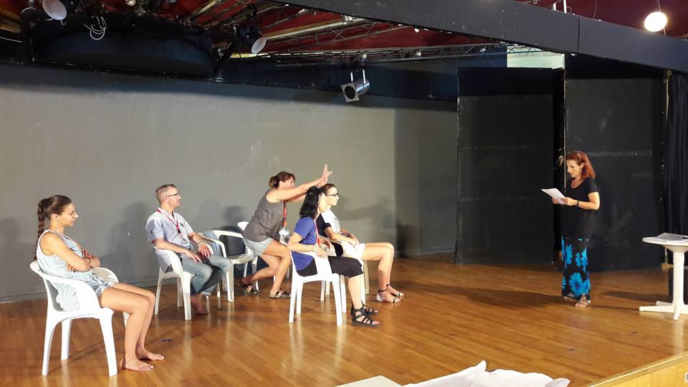

Slide 5
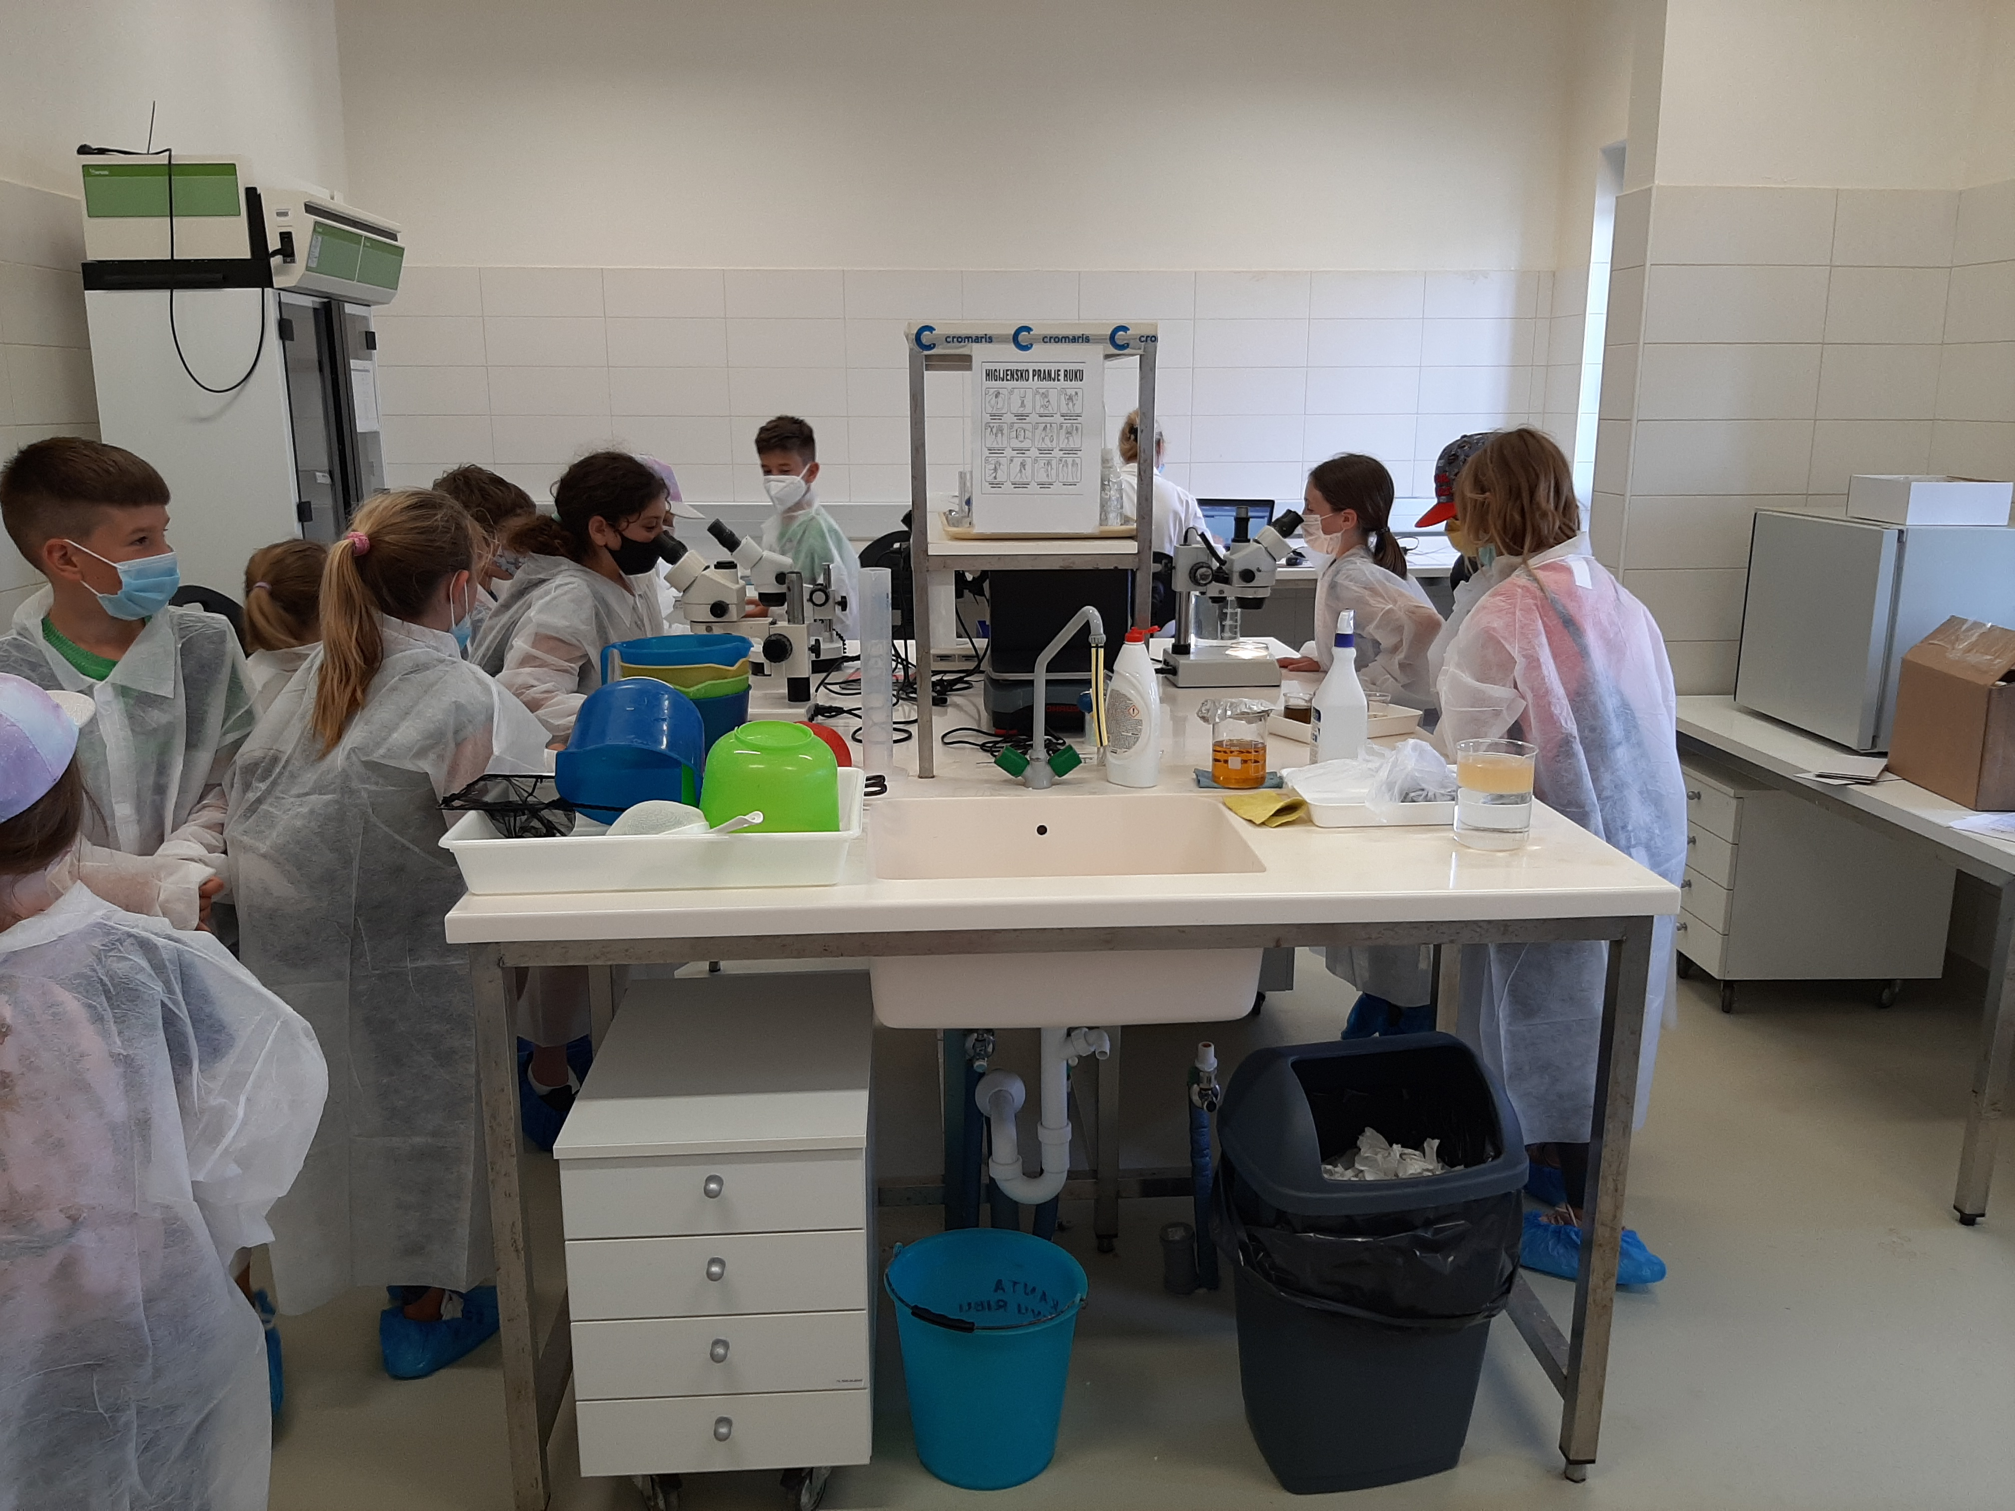
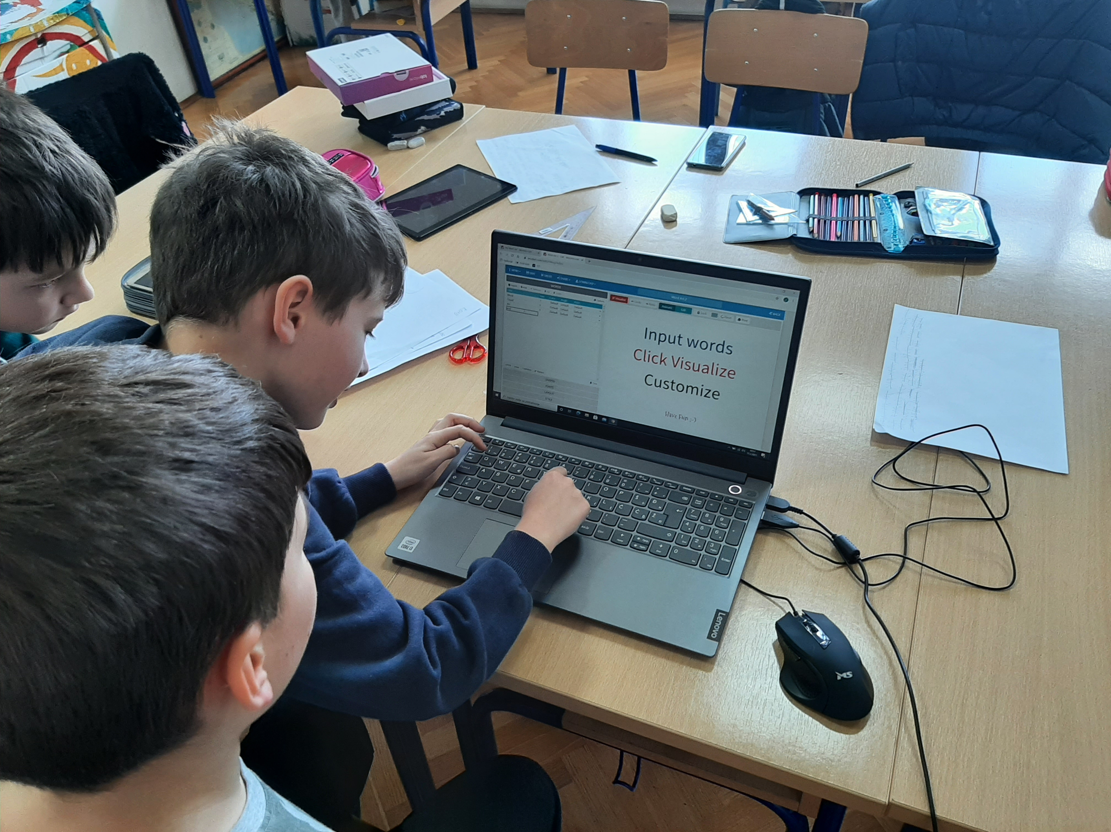
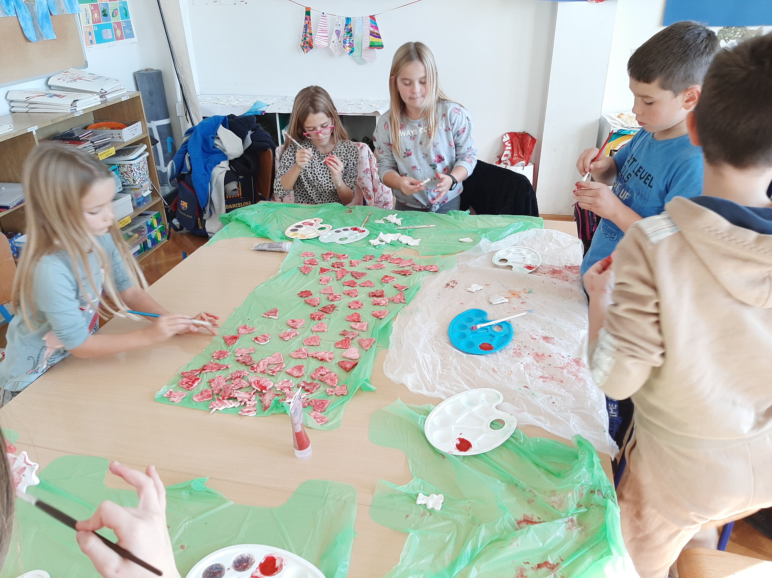

Slide 6
I am interested in:
new ways of teaching and innovative approaches for children with different abbilities.
courses about gifted students' education, learning in the academic education of inclusive students.

Slide 7
This publication [communication] reflects the views only of the author, and the Commission cannot be held responsible for any use which may be made of the information contained therein.

