Slide 1
Erasmus Days 2021 in Primary School „Petar Zoranić” Nin, Croatia
Project Team
October 14, 2021

Slide 2
Marina Diklić Matešić
I work as a history teacher since 2006. I like working on projects involving history, politics, human wrights, active citizenship and cultural heritage.

Slide 3
Project FAST
Fun, Authentic, Simple and Trustworthy
2017 -2020
Main objective: gaining and improving the use of ICT tools and digital methods adapted to the pillars of the "21st century skills" and the aspects of Bloom's digital taxonomy
Project members came from Denmark, Norway, Croatia, Slovenia and Poland

Slide 4
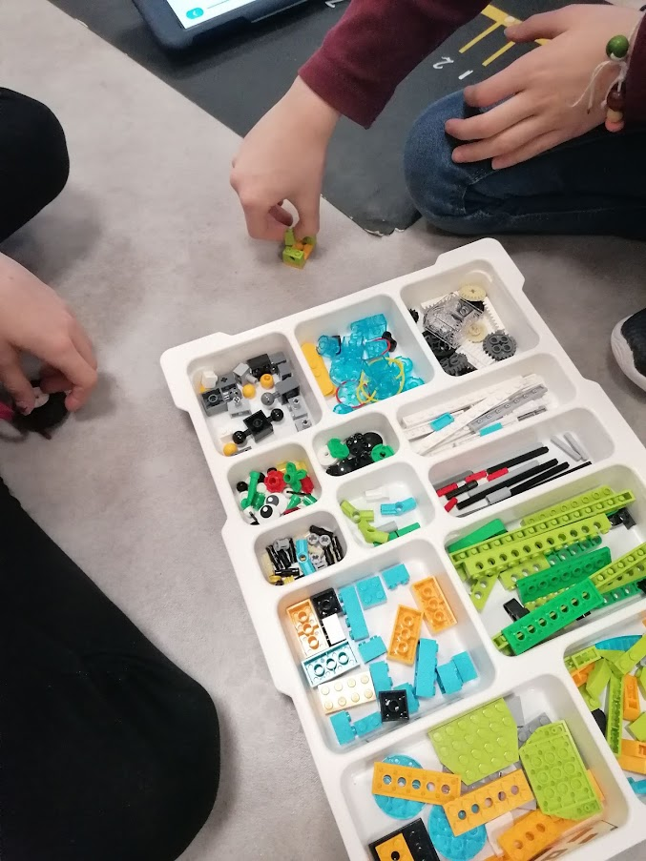
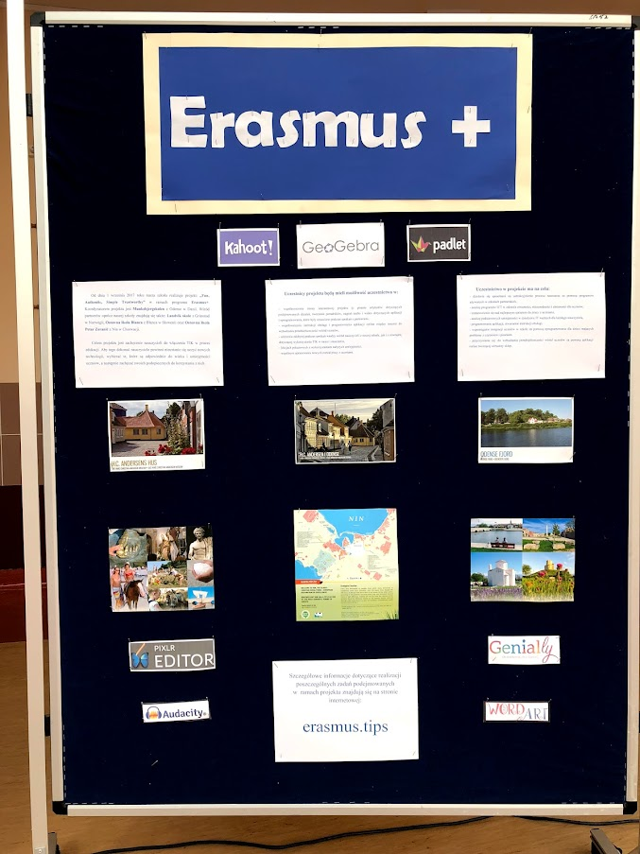
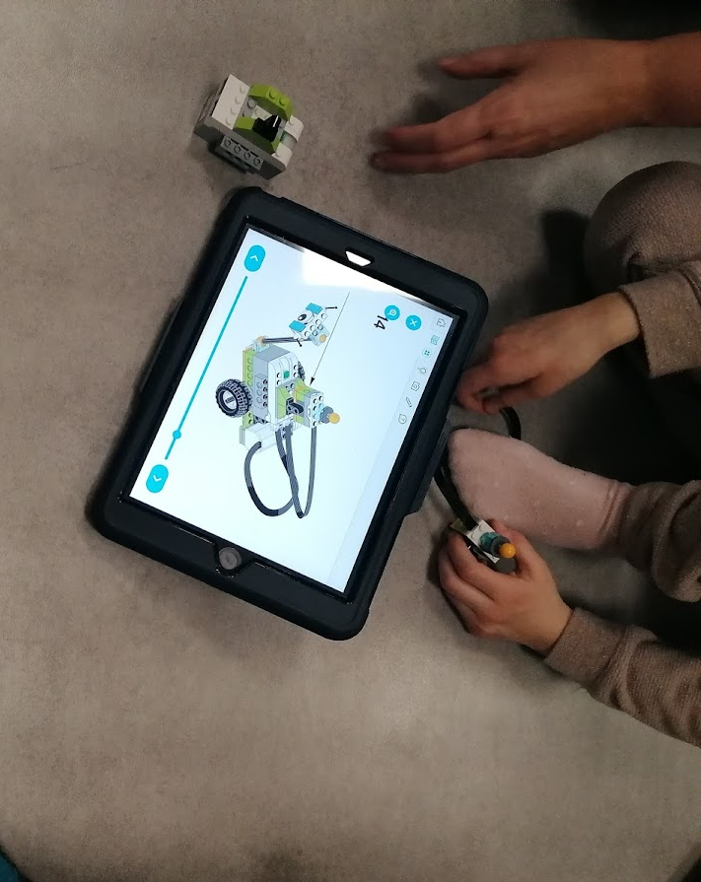
We enjoyed and learned a lot during our monthly tasks and project meetings

Slide 5
Legends and fairy tales project
November 2019
Pupils from partner schools in Poland, Slovenia, Norway and Croatia made interesting presentations and videos
We met online through Skype on Thursday, 28th of November and showed what we had done.

Slide 6
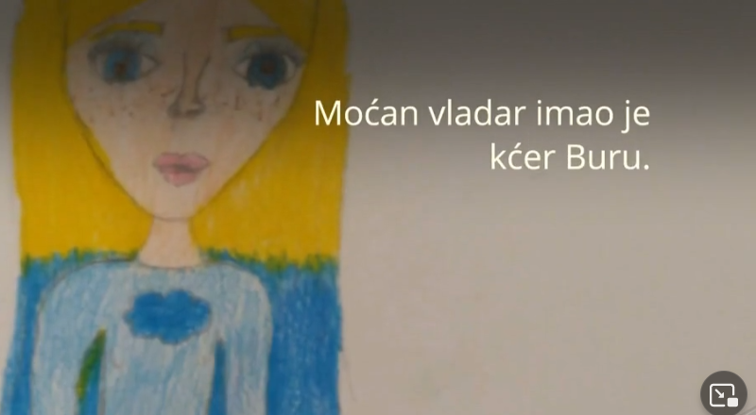
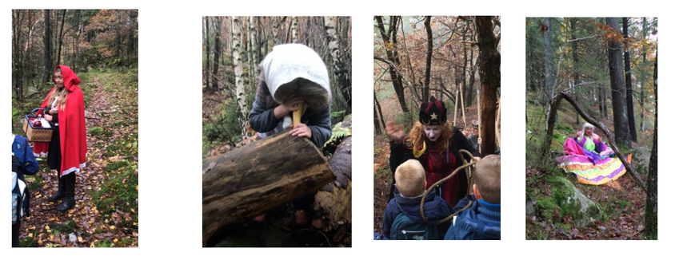

Slide 7
Current projects and interests:
Local heretage
Rememberance days
Cyberbulling

Slide 8
This publication [communication] reflects the views only of the author, and the Commission cannot be held responsible for any use which may be made of the information contained therein.

