Slide 1
Erasmus Days 2021 in Primary School „Petar Zoranić” Nin, Croatia
Project Team
October 14, 2021

Slide 2
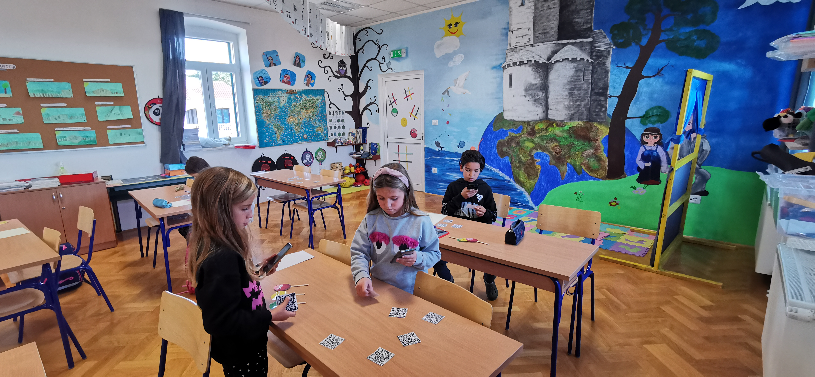
Martina Jelenković
I'm primary school teacher in Osnovna škola "Petar Zoranić" Nin

Slide 3
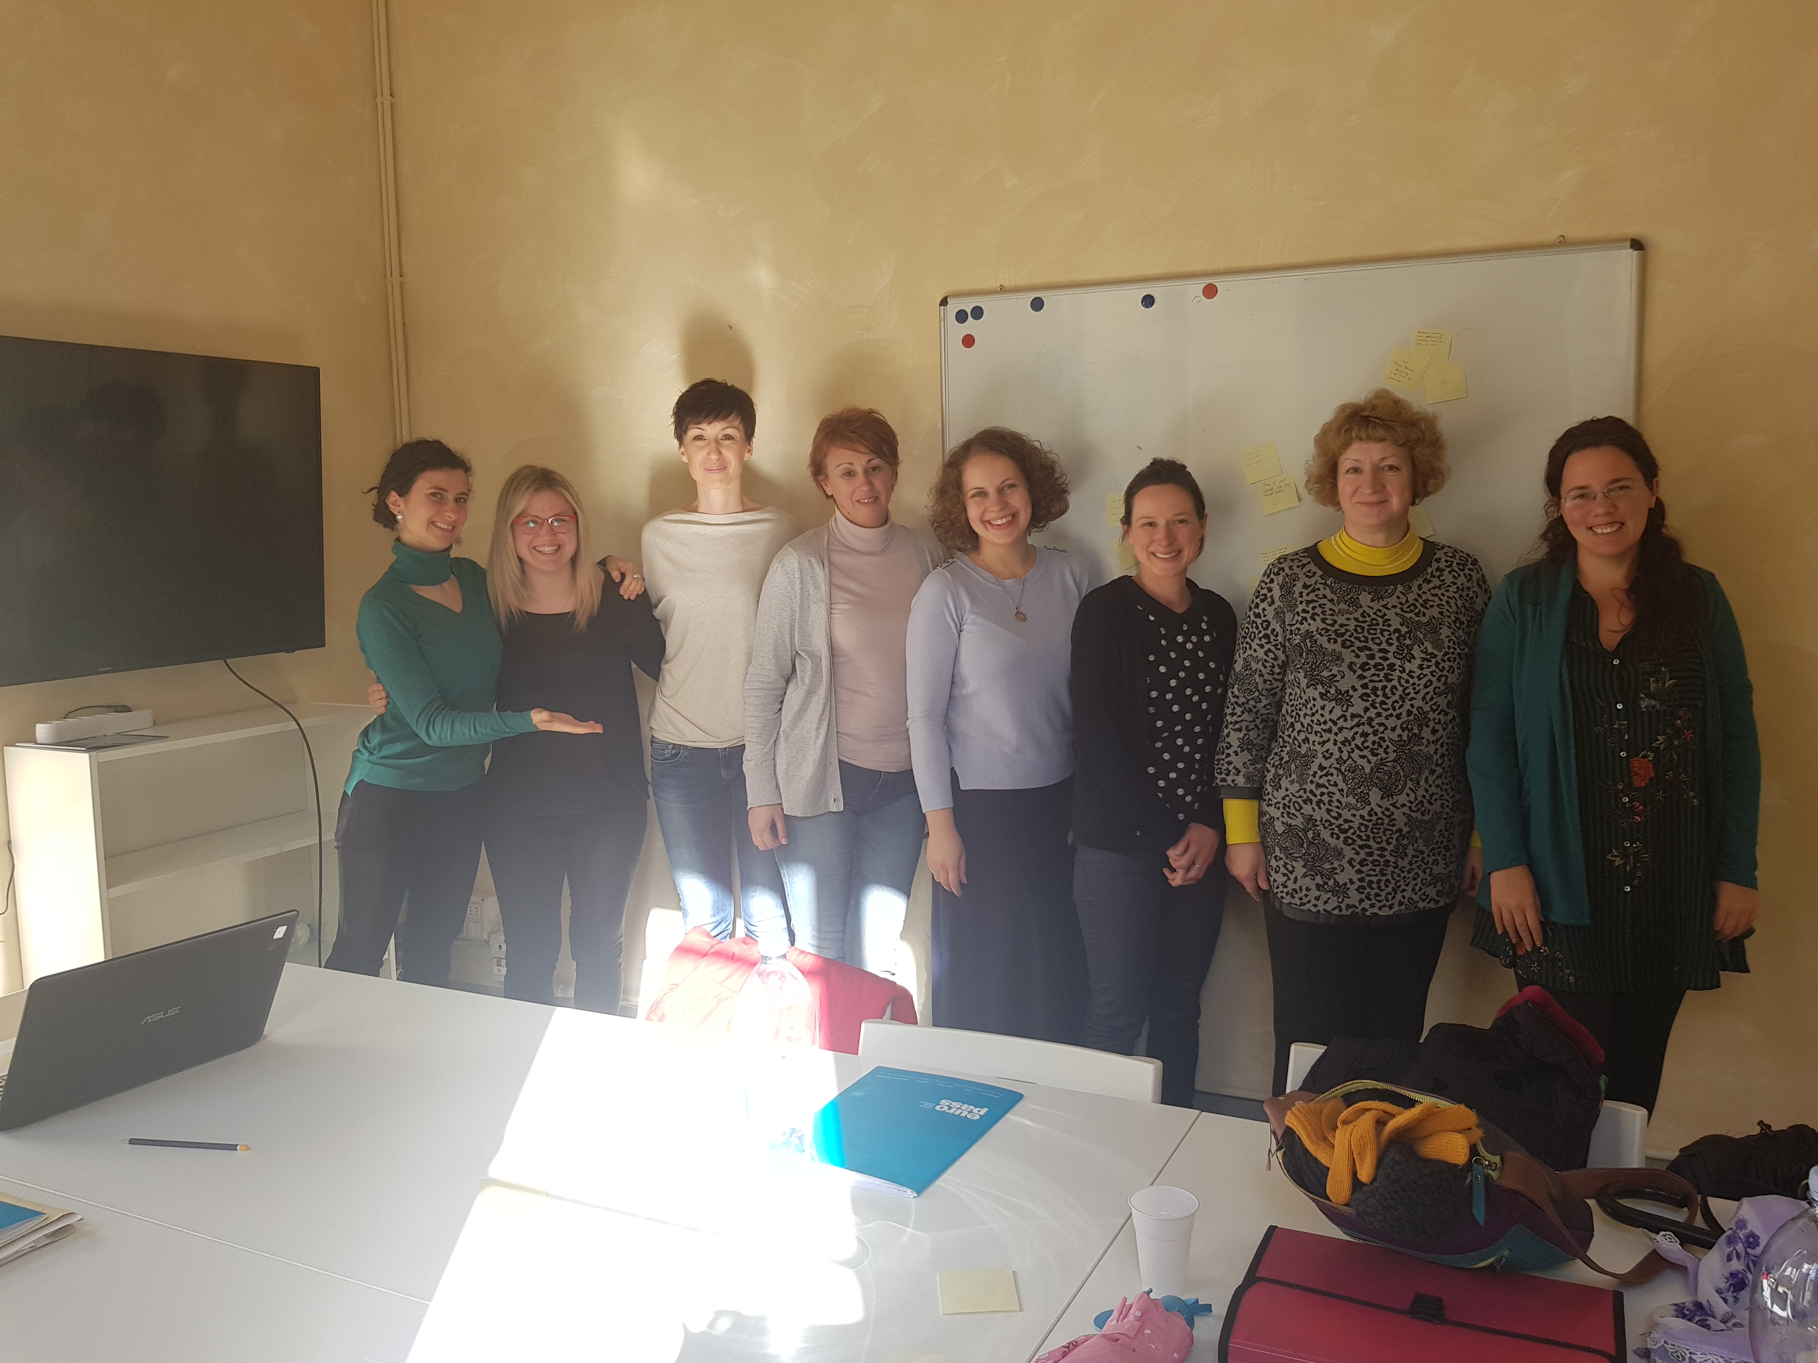
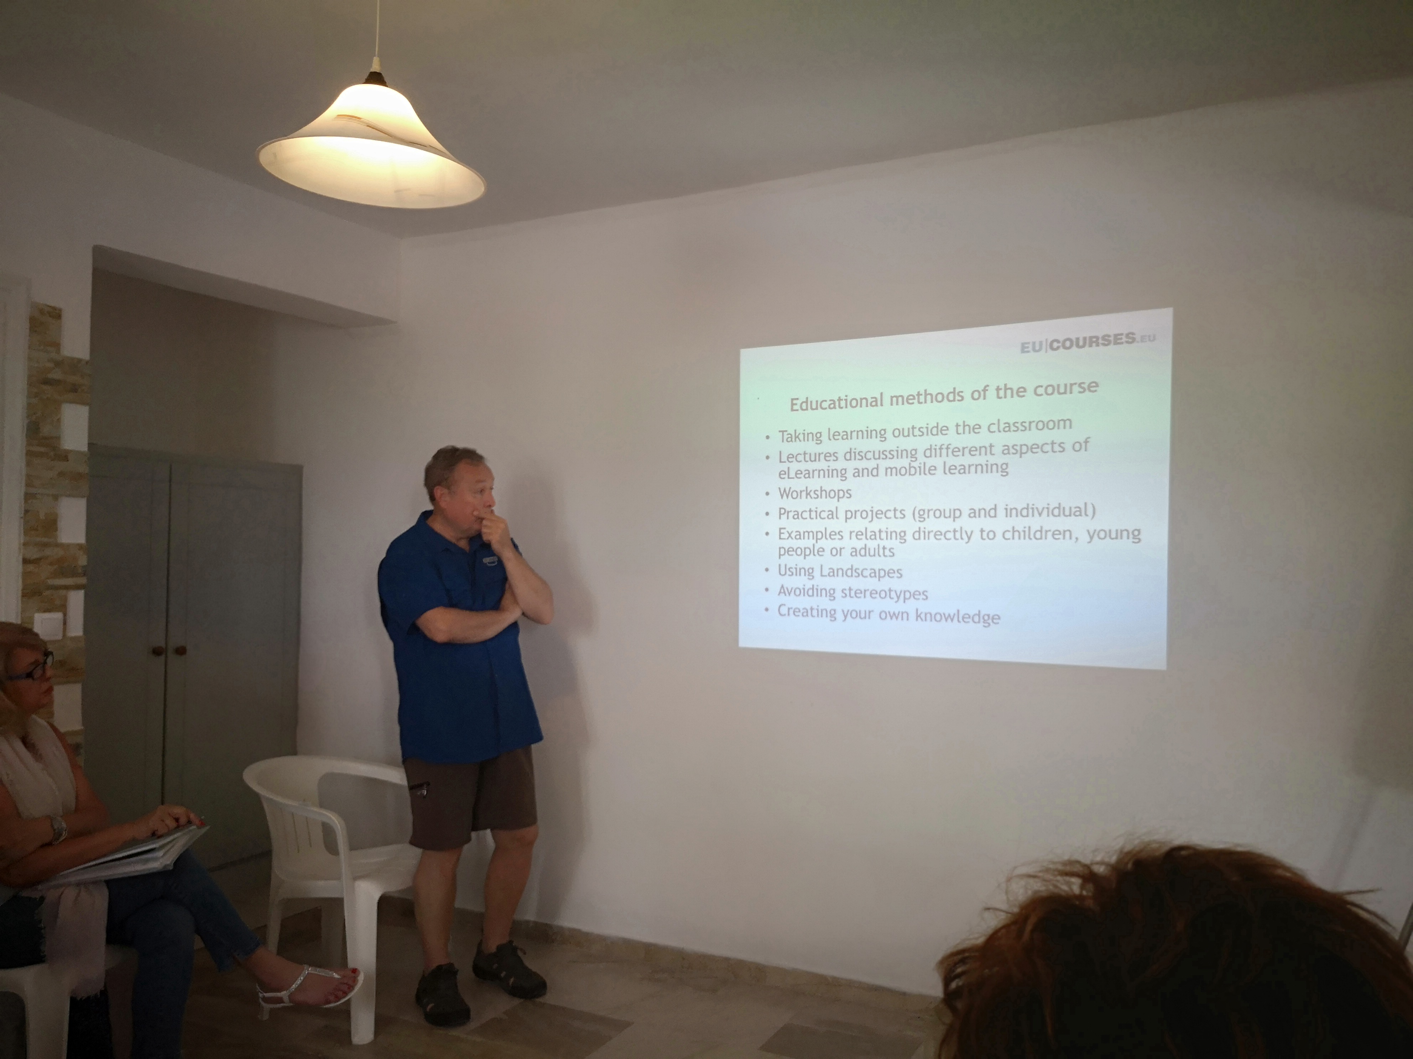
Structured courses:
Student-centered methodlogy: teachers as promotors of active learning (Florence, 2018.)
Sharing Landscapes (Santorini, 2018.)

Slide 4
KA2
Wearable Methodology (project partners Anton Diaz School and the University of Castilla La Mancha ( Spain), Bulgaria St. Kliment Ohridski School)
Project FAST ( Fun, Authentic, Simple and Trustworthy, 2017. -2020.)
Project partners were from Denmark, Norways, Slovenia and Poland

Slide 5
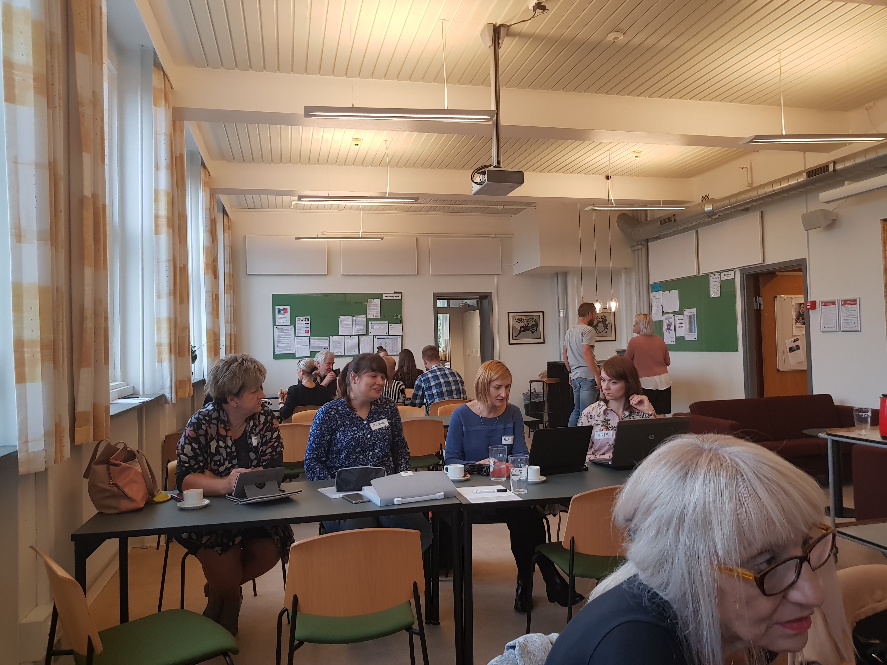
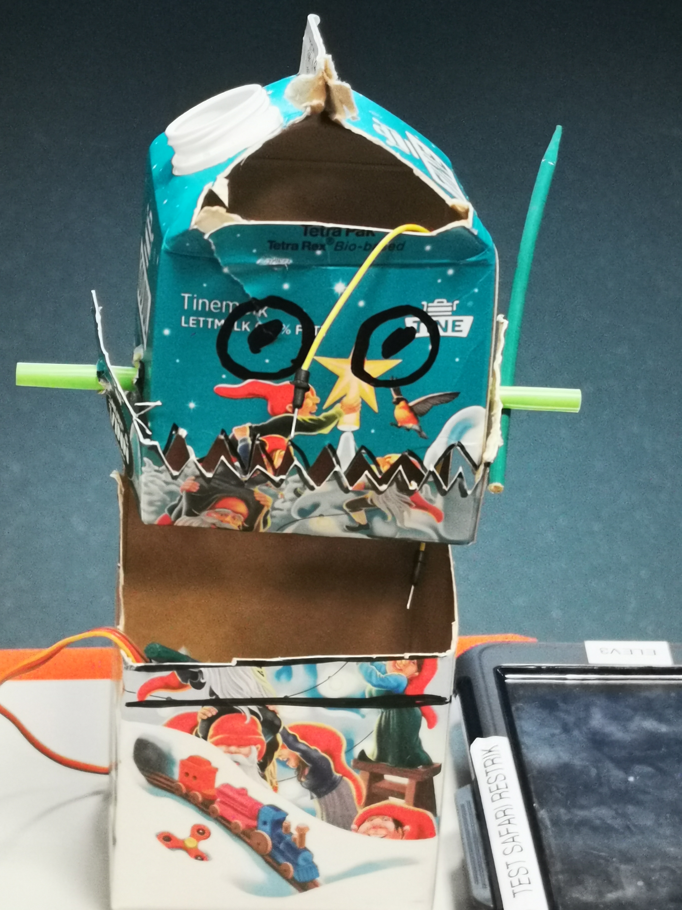
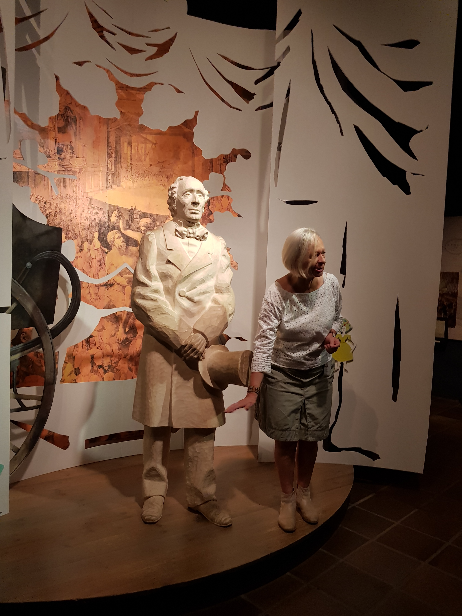
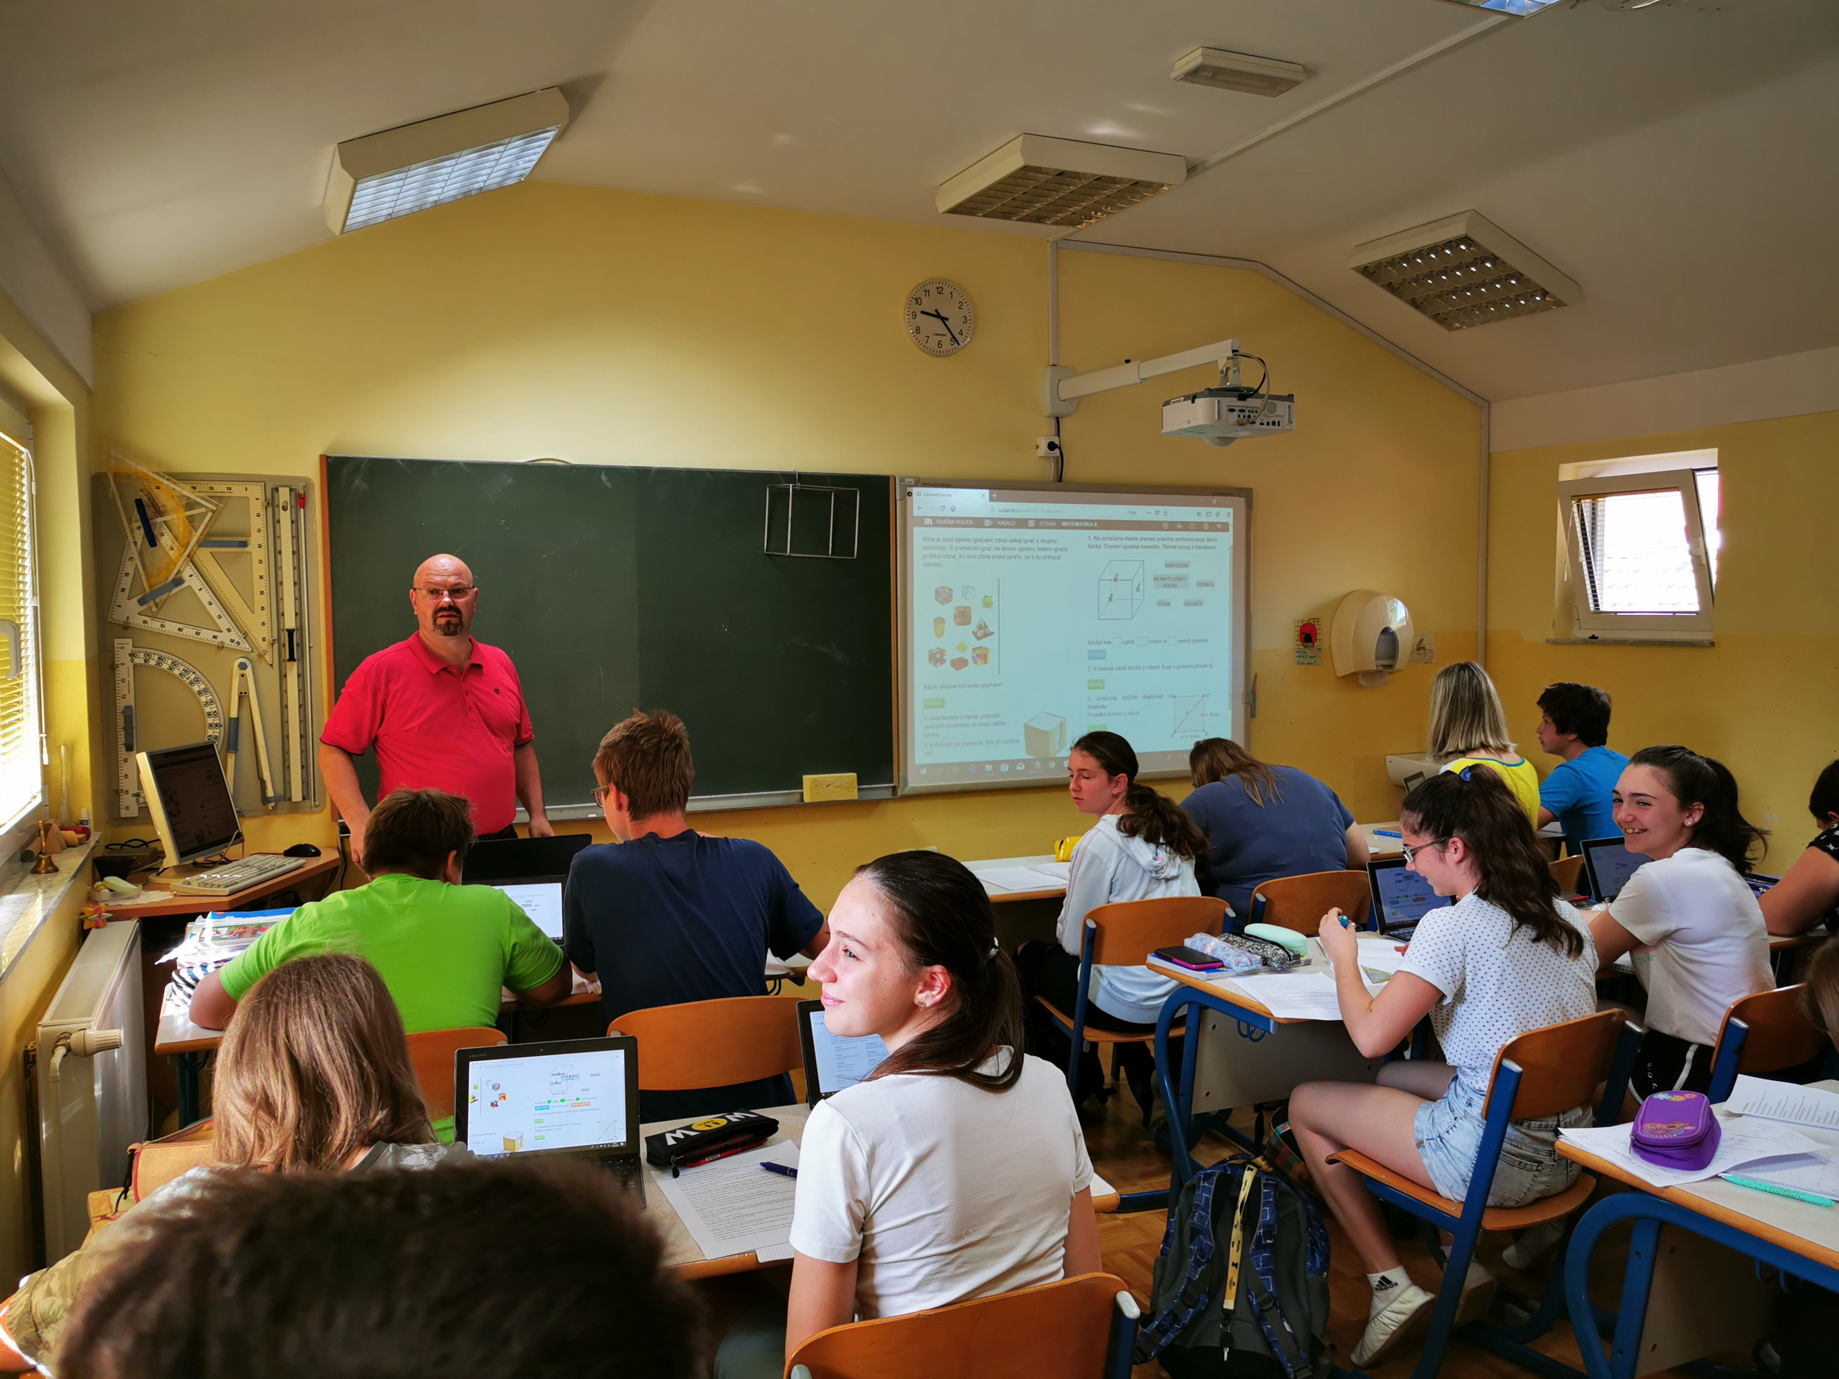
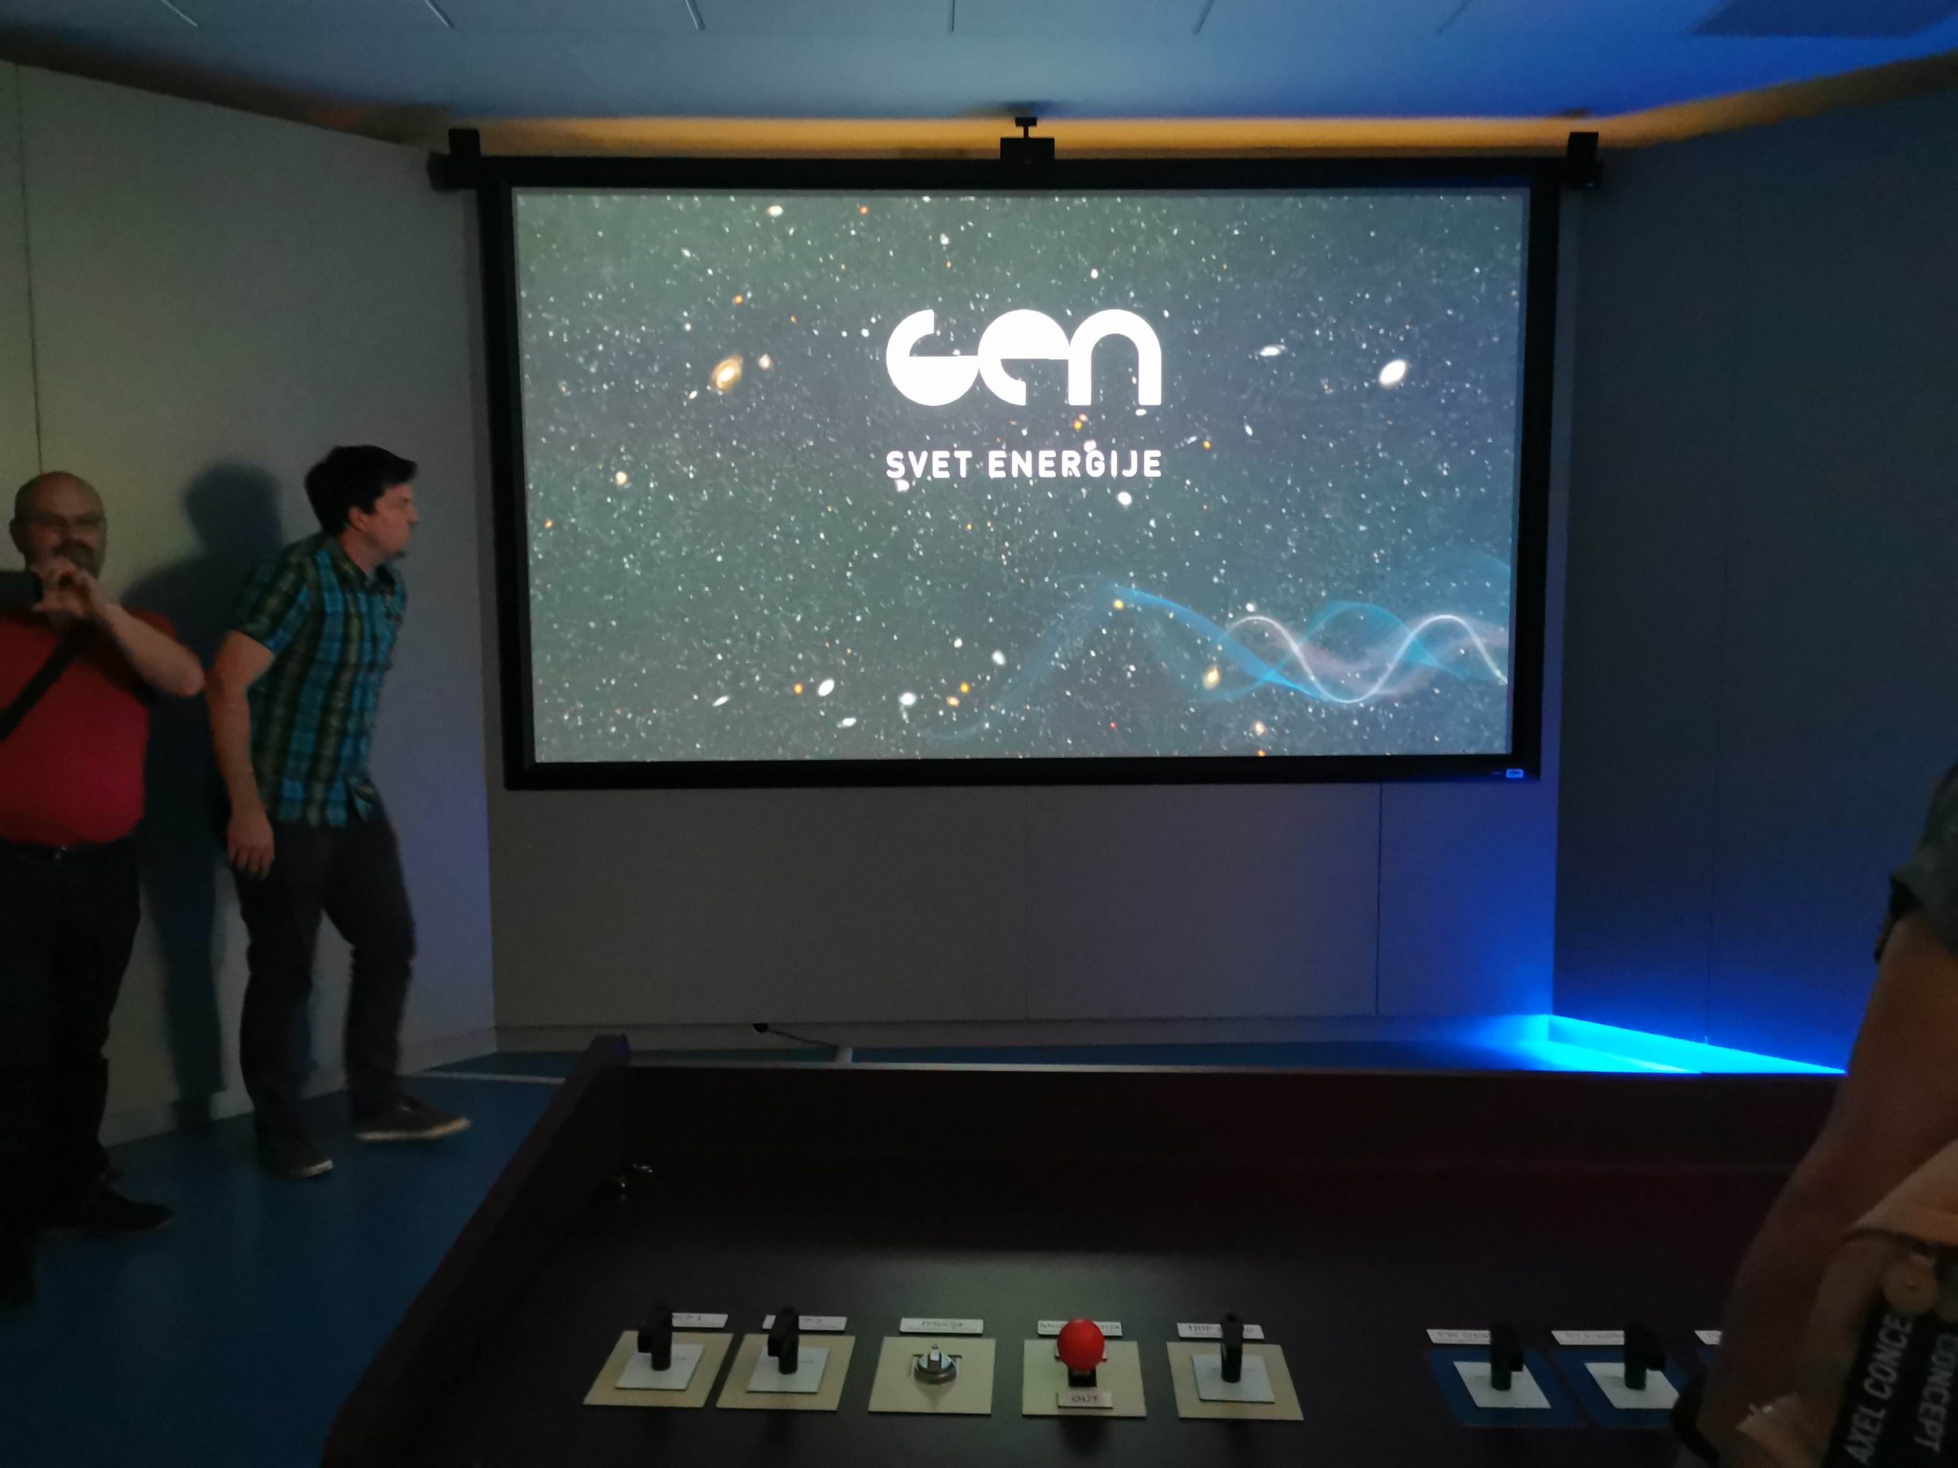

Slide 6
Future interests
special needs students (students with disabilites and gifted students)
inclusion

Slide 7
This publication [communication] reflects the views only of the author, and the Commission cannot be held responsible for any use which may be made of the information contained therein.

