Slide 1
Erasmus Days 2021 in Primary School „Petar Zoranić” Nin, Croatia
Project Team
October 14, 2021

Slide 2
Mirjana Ivanković Miletić

Slide 3
- projects
- Wearable Methodology
in which I designed SPELL IT game that was used to make bracelets for the project.
Erasmus accreditation – 2021 – 2027,
only 7 schools

Slide 4
Mobilities I would like to go to in near future
-learn and practice how to better implement games and art in language teaching.
-students with dyslexia and dysgraphia who find foreign languages more difficult to follow than other students.
I would implement what I learn in my daily foreign language classes.

Slide 5
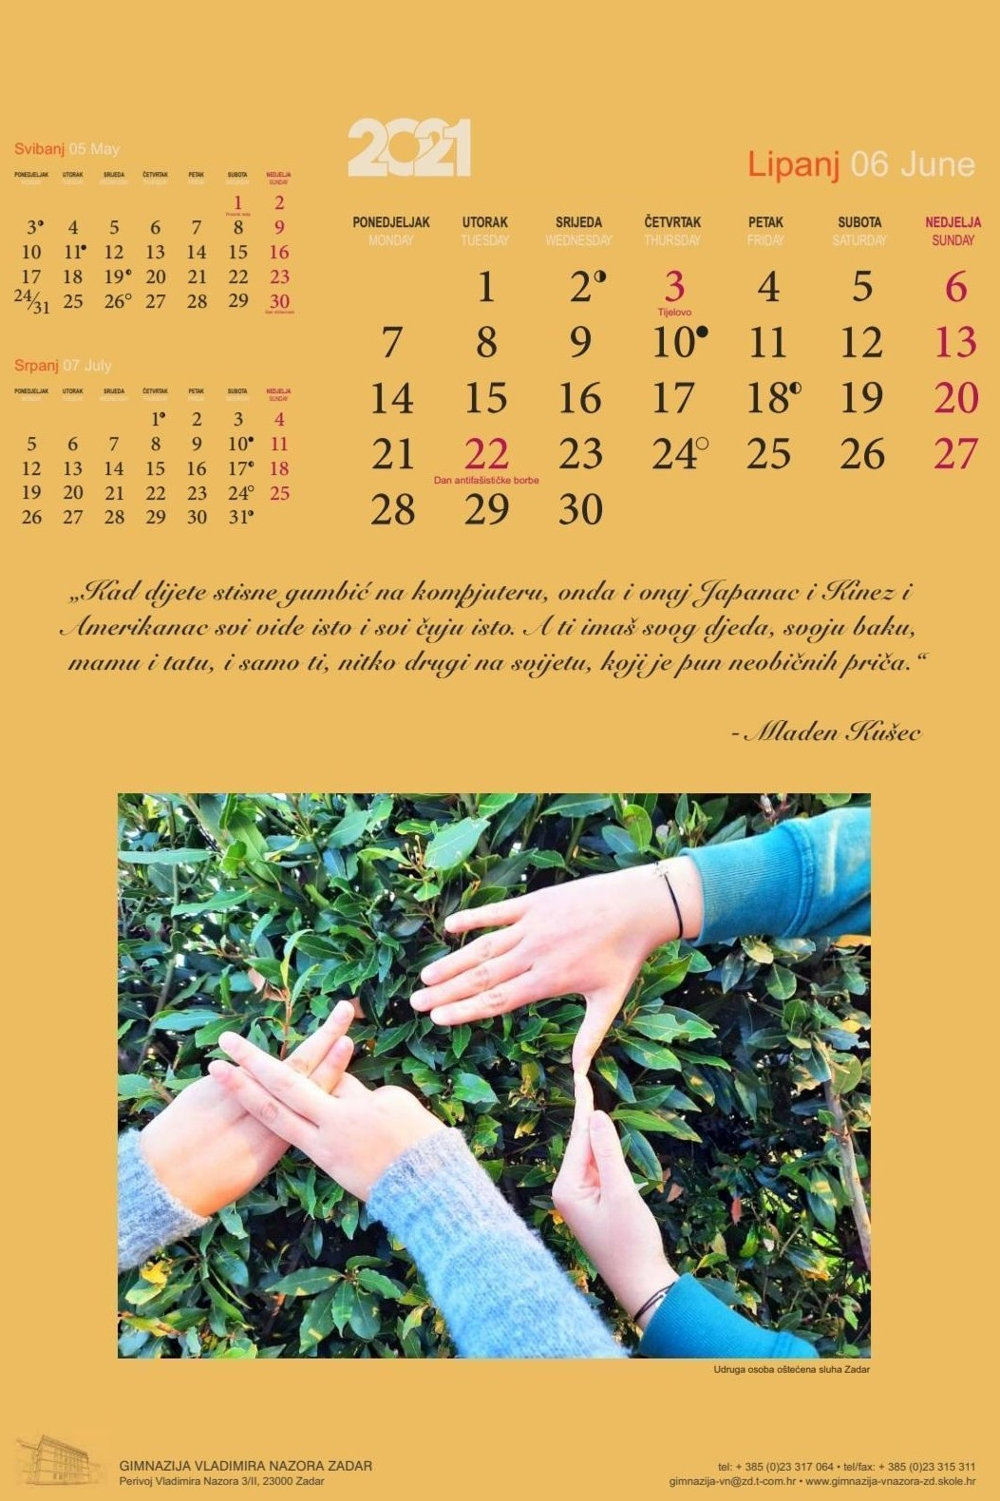
Projects with pupils 2021/2022
Calendar for 2022 – implementing art in language learning
Learning sign language
Collaboration with Croatian

Slide 6
This publication [communication] reflects the views only of the author, and the Commission cannot be held responsible for any use which may be made of the information contained therein.

